Slide 1

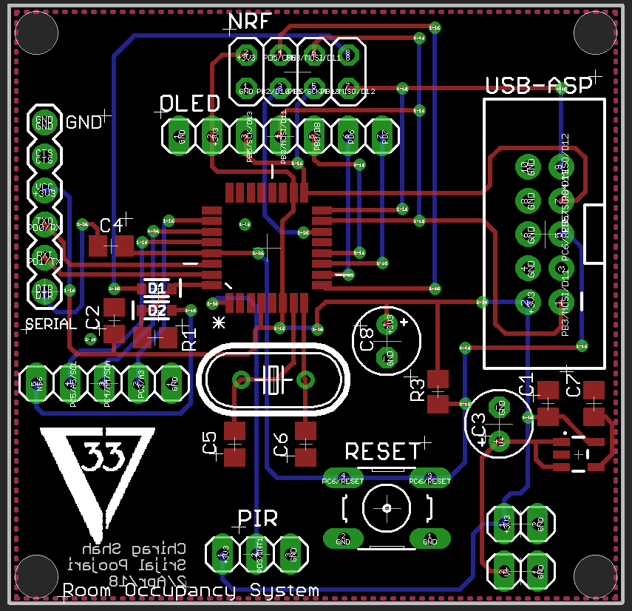
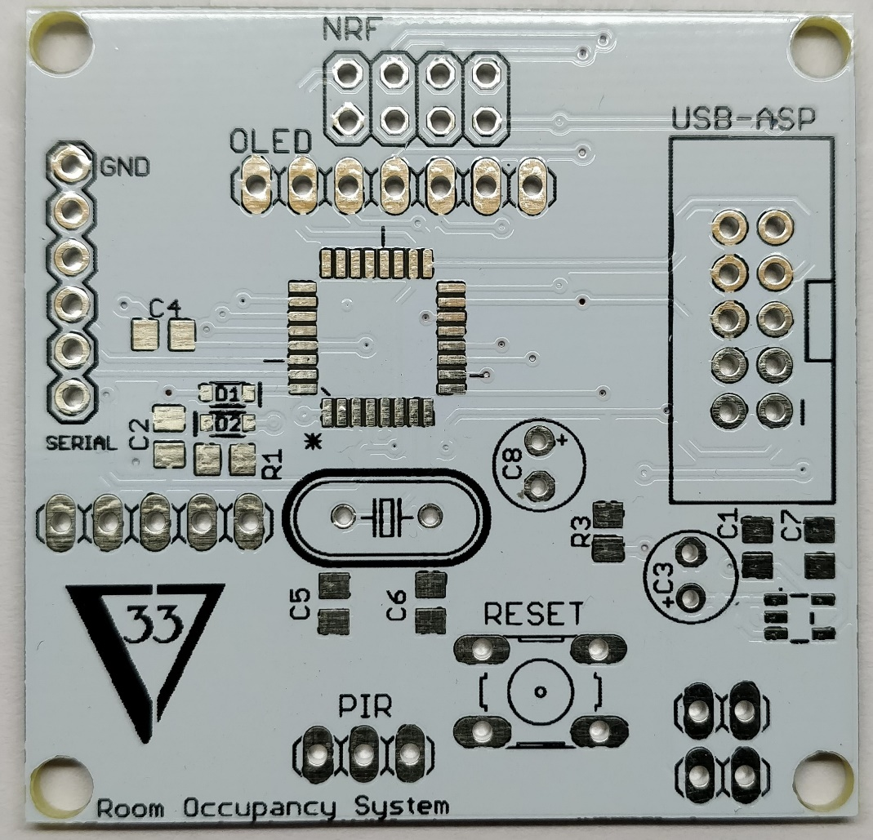
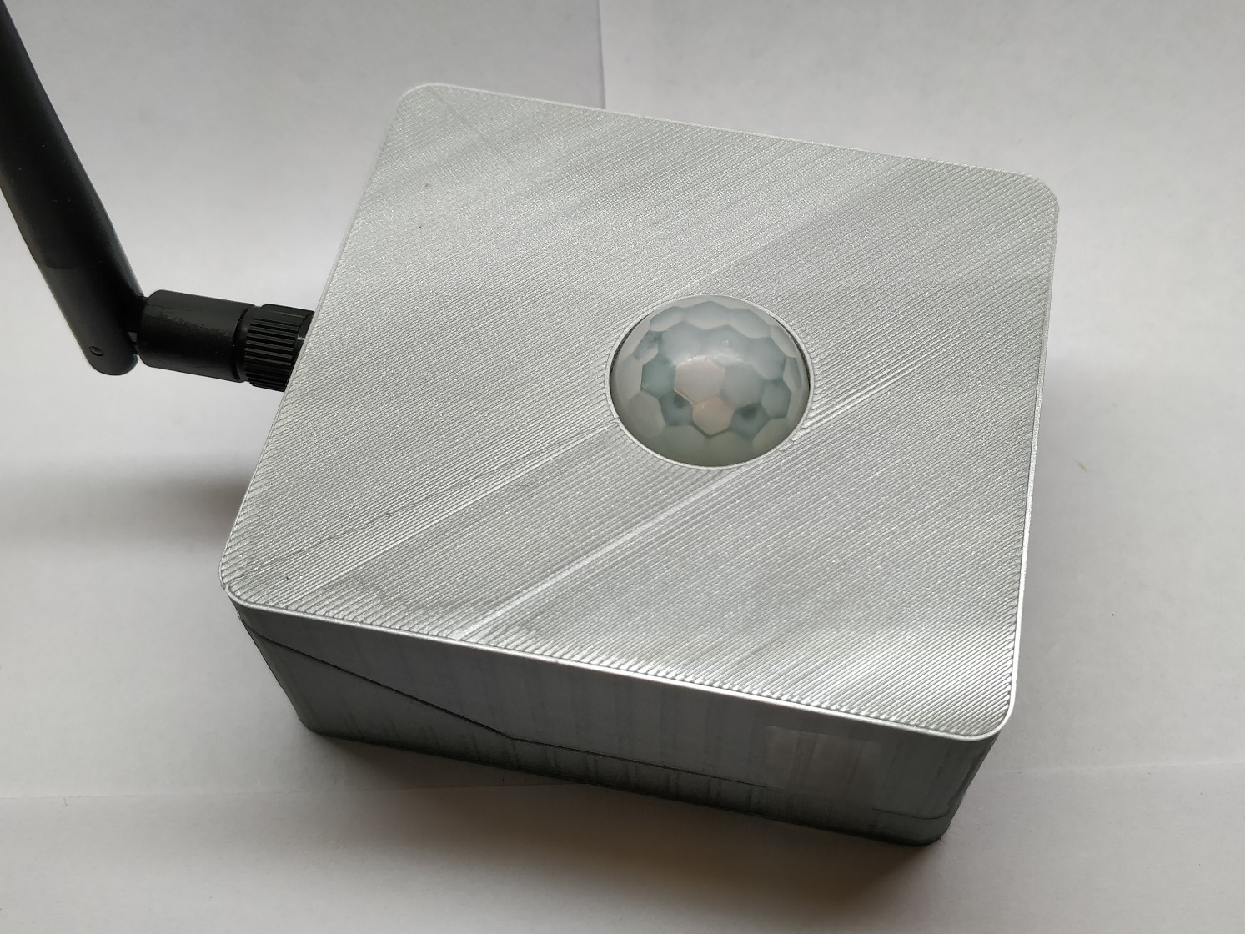
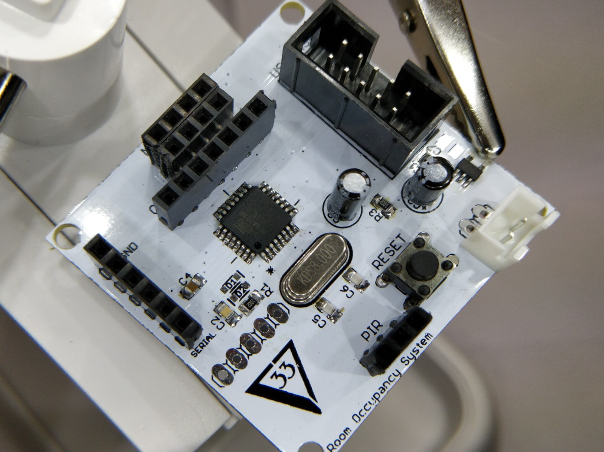
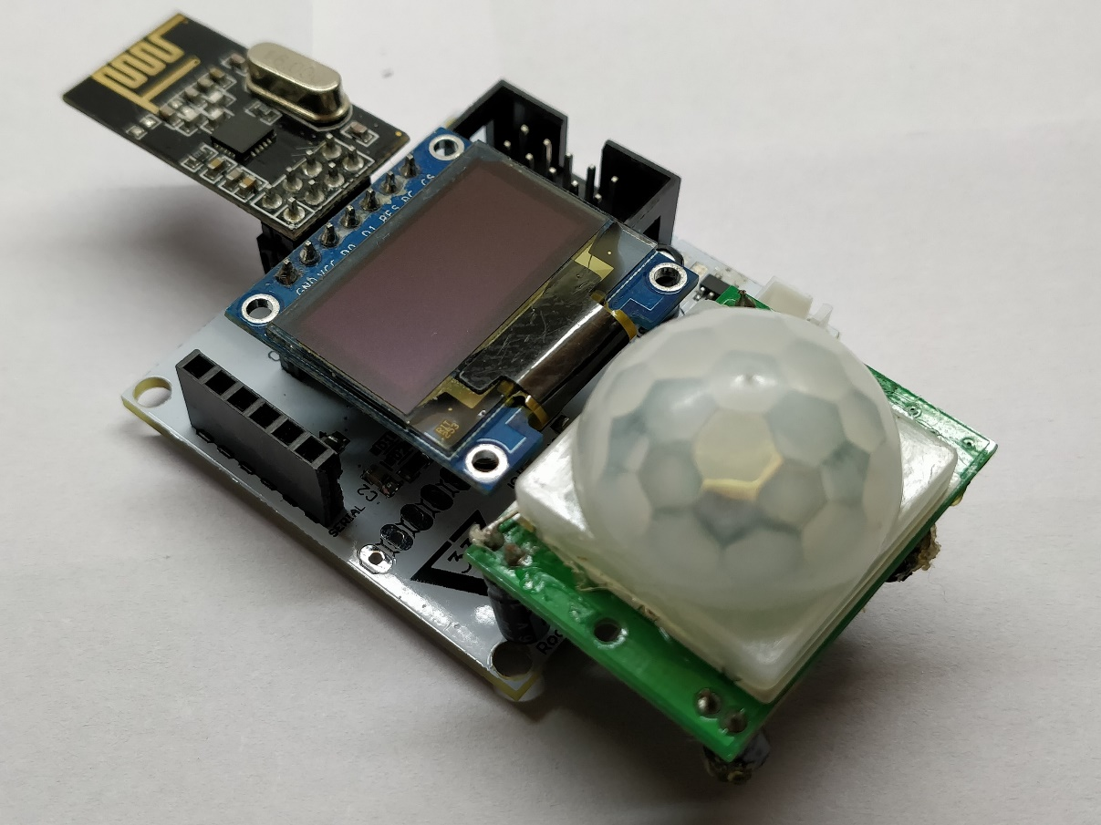
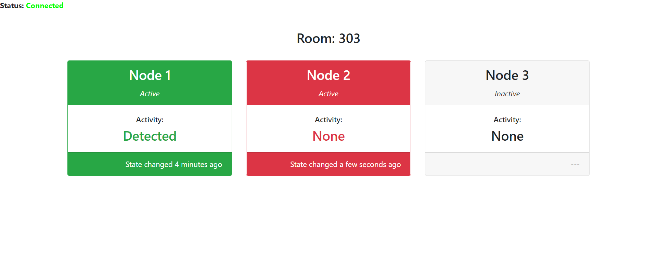
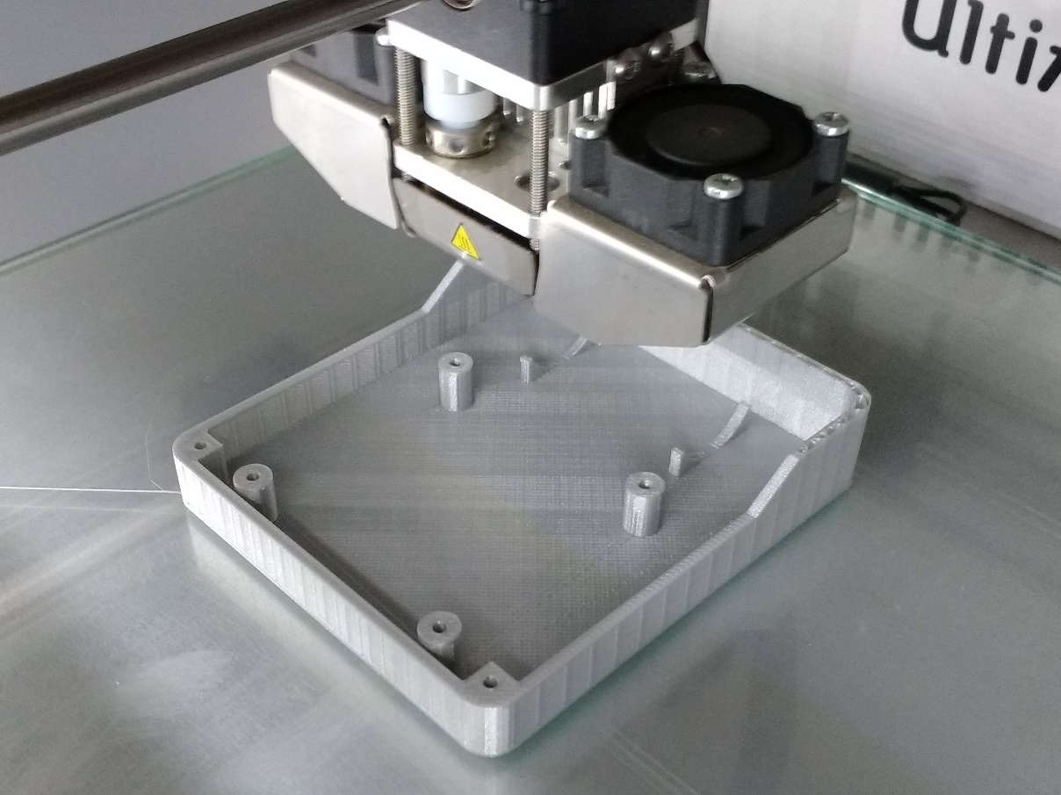
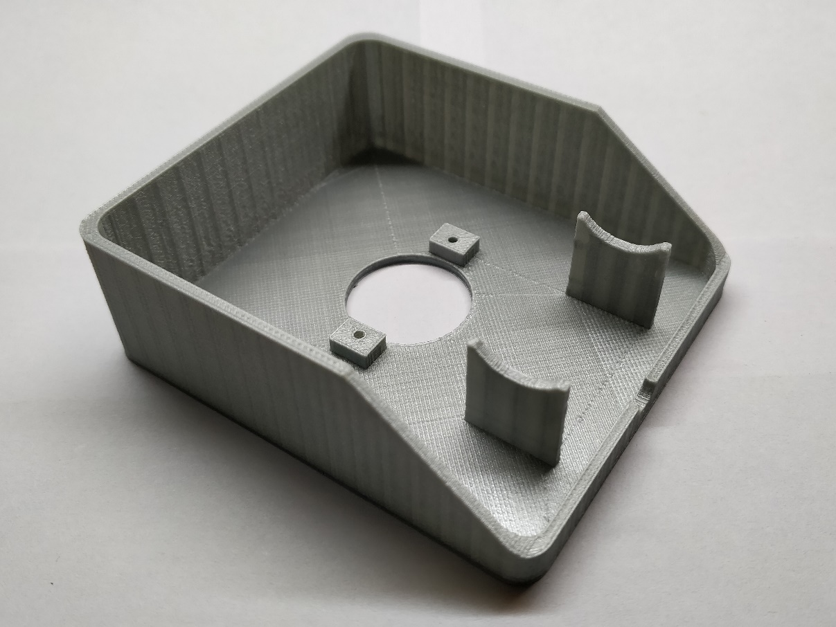
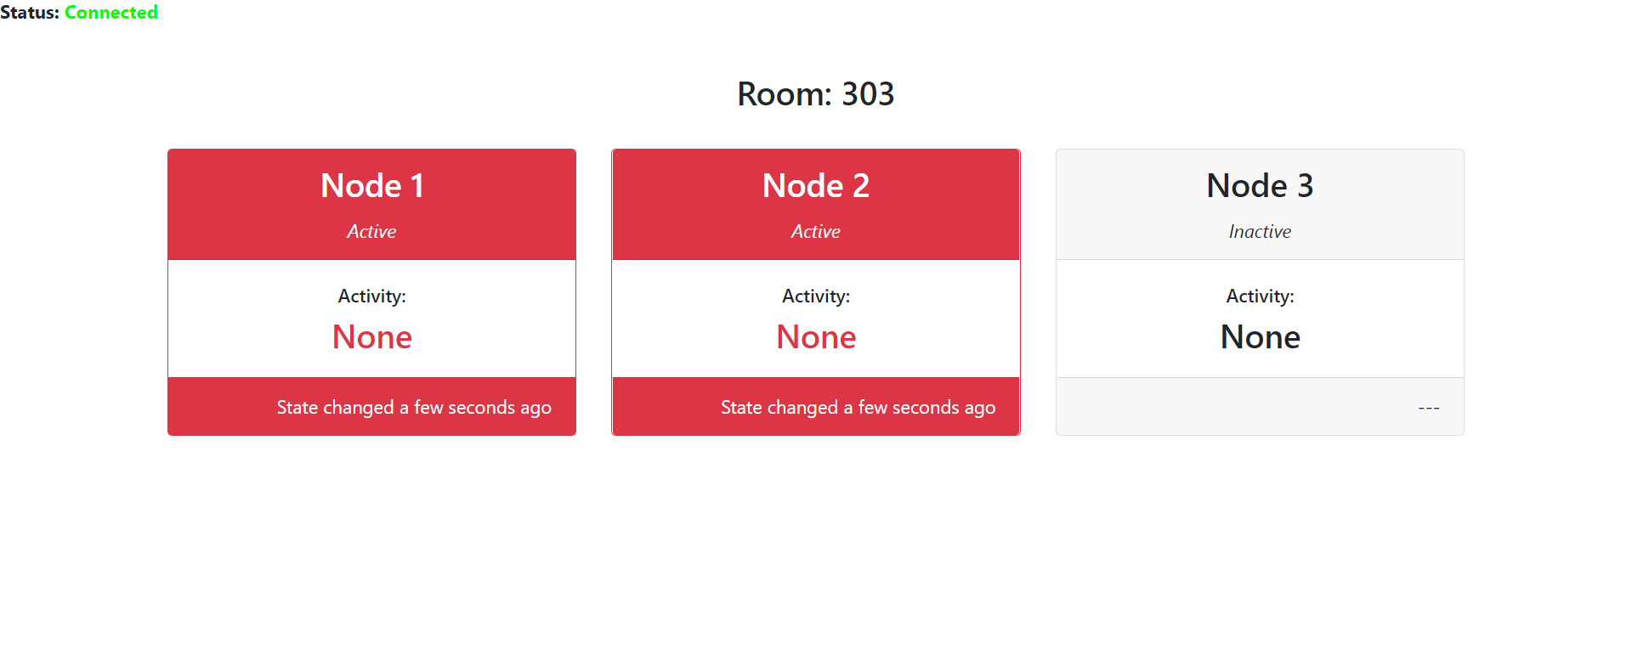
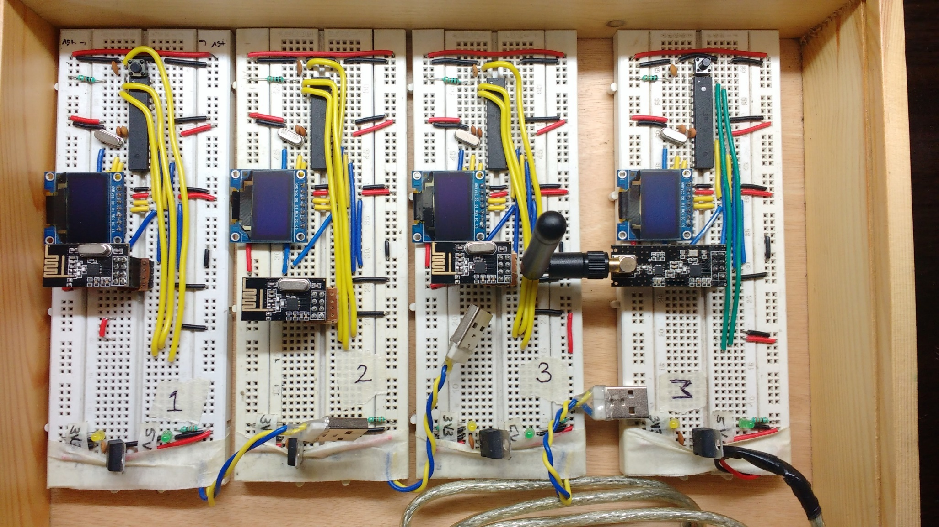
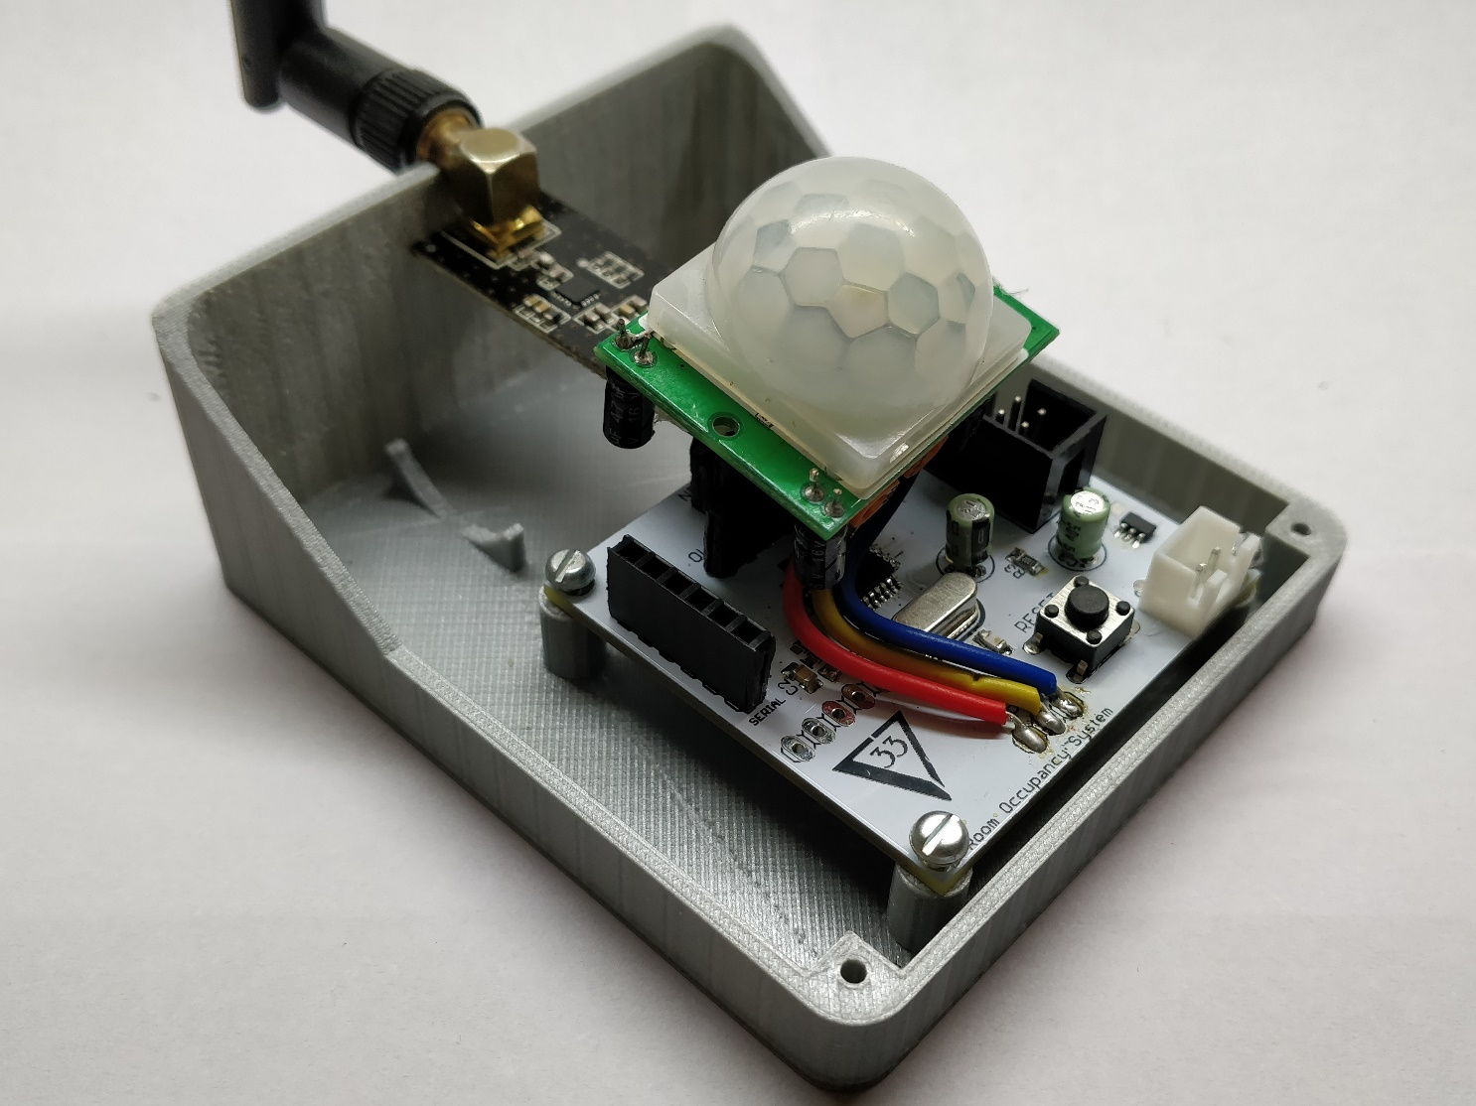
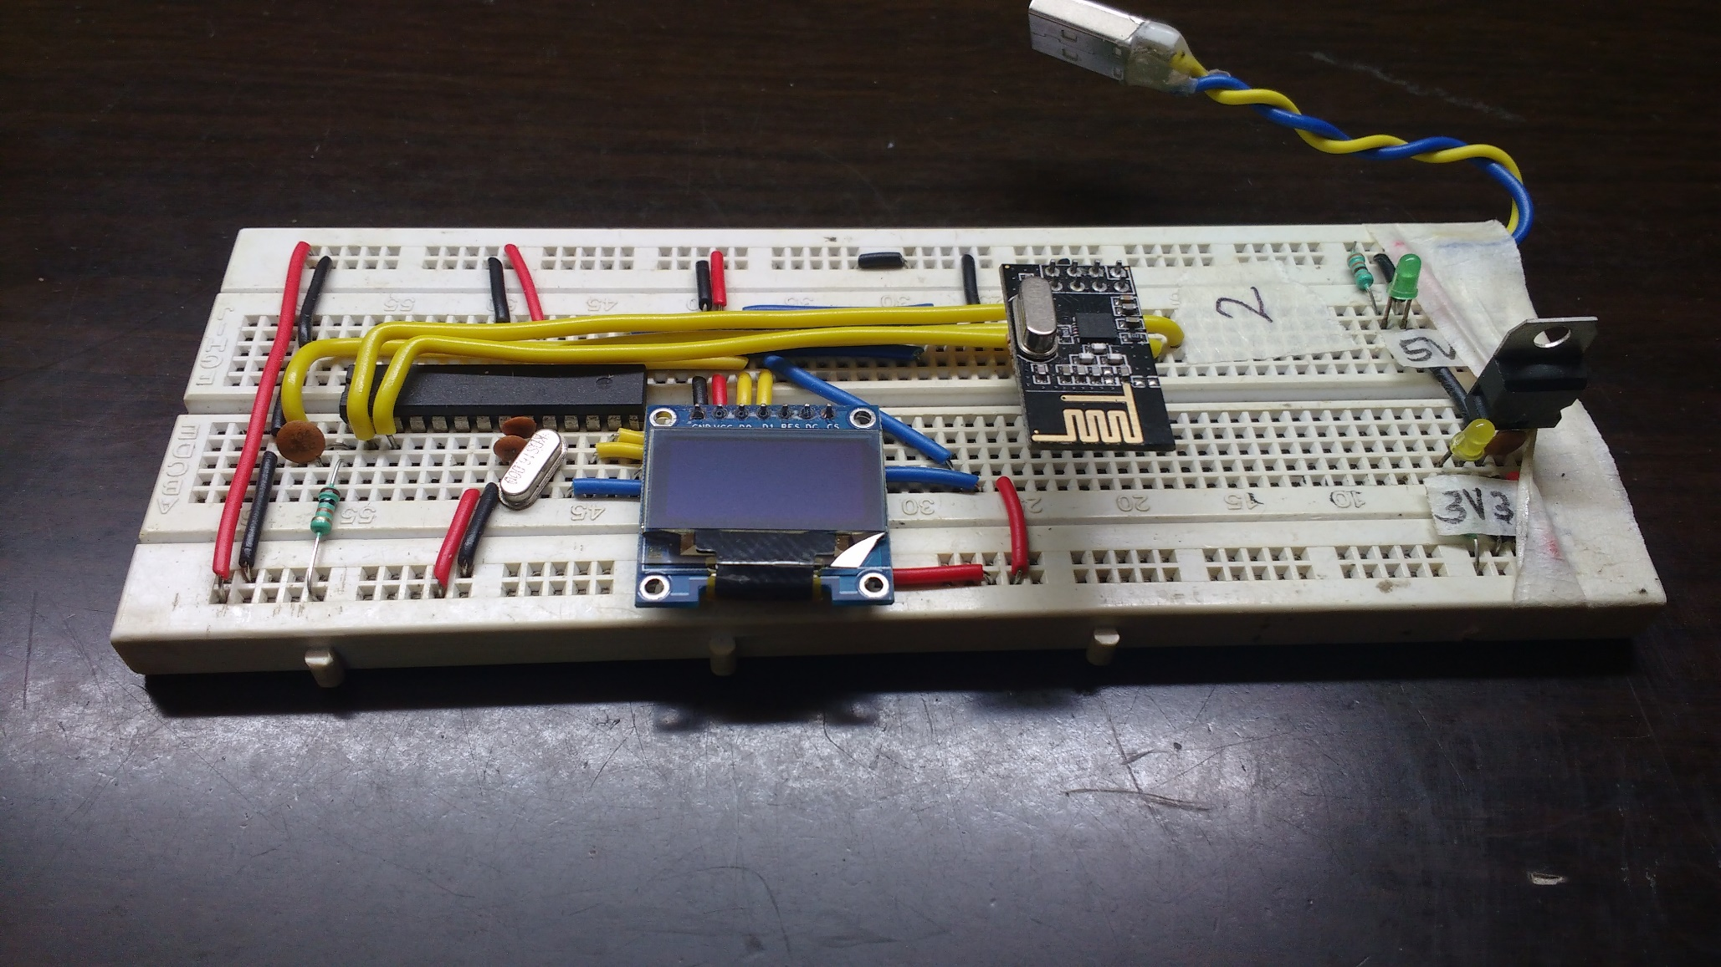
Low Cost Real-time Room
Occupancy Indicating System
Chirag Shah, Srijal Poojari Guide: Prof. Priya Deshpande
Department of Electronics Engineering, Sardar Patel Institute of Technology, Andheri (West), Mumbai-400058
Introduction
Designed the PCB of the circuit in Eagle and got it manufactured from a PCB prototyping service (PCBway.com)
Highlights
The objective of this project was to tackle a problem faced by corporate environments.
In a typical corporate environment there exists multiple conference/meeting rooms.
Anyone can book any meeting room for any time (if the room is available) using a mobile app.
We created a complete end-to-end product
Designed a network of wireless battery operated devices with PCBs professionally manufactured
3D printed the product housing
Designed the web interface
Problem Definition
Results
Employees require frequent access to these meeting rooms, but lack of real-time knowledge of its availability leads to inconvenient hassle.
The problem was that anyone could book a meeting room and then not use it. Or if someone wanted to have a meeting without pre-booking the meeting room the he/she would have to go from room to room to check the availability of the rooms. The would create a lot of unnecessary hassle and would lead to unoptitmal utilization of the workspace.
The end product
We assembled the board
Solution Design
We used a PIR sensor to detect occupancy of the room.
The sensor is connected to an Atmel microcontroller which relays the information to a central device via radio modules configured in a tree configuration.
The central device is connected to a PC and it will push the data to the internet via a python script running on the PC.
All the devices are battery powered.
To reduce the power consumption, we used a low dropout voltage, low quiescent current voltage regulator. This improved the quiescent current to 20uA compared to 5mA used by a standard voltage regulator like a LM1117. Also the dropout voltage improved to 200mV from a typical 2v.
Web interface showing the occupancy status each room
We manufactured the housing unit using 3D printing
Work Done
Designed the prototype of the circuit on breadboards which included the microcontroller, radio module and an OLED display
Inside the housing of the final product
Conclusions
The standby current of the device is only 80uA. This significantly improves the battery life.
The cost per device is about 900 Rupees.
Future scope of this project includes
Testing with increased number of nodes
Building a Mobile Application
Implementation at Fractal Analytics
References
Web interface to show the occupancy status of each room
[1] Sparkfun.com, “nRF24L01+ Transceiver Hookup Guide”, [Online]. Available:https://learn.sparkfun.com/tutorials/nrf24l01-transceiver-hookup-guide [Accessed: 10-Feb-2018]
[2] geekstips.com, “Internet of Things Project – Communication between ESP8266 modules”, [Online]. Available: https://www.geekstips.com/two-esp8266-communication-talk-each-other/ [Accessed: 10-Feb-2018]
[3] Scargill, “Networking the nef24l01”, [Online]. Available:https://scargill.wordpress.com/2013/05/17/networking-the-nrf24l01/ [Accessed: 10-Feb-2018]

